Slide 1
Strings: Conversions, Indexing, Slicing, Immutability.
Week 3 | Lecture 1 (3.1.2)
While waiting for class to start:
Download and open the Jupyter Notebook (.ipynb) for Lecture 3.1.2
You may also use this lecture’s JupyterHub link instead (although opening it locally is encouraged).
Upcoming:
Reflection 3 released Friday @ 11 AM
Lab 3 deadline this Friday @ 11 PM
TUT (Tutorial) this week is ONLINE
PRA (Lab) on Friday @ 2PM this week (ONLINE)

Slide 2
Today’s Content
Lecture 3.2.1
Objects & Strings: Operators and Methods
Lecture 3.2.2
Strings: Conversions, Indexing, Slicing, and Immutability

Slide 3


Working with Strings
The string (str) type was briefly introduced in previous weeks
Let’s take our string knowledge to the next level!
escape sequences
str operations
type conversion
str indexing and slicing
str methods

Slide 4
Consider this…
Ask the user how many times they would like to see the string ”knock knock knock… Penny” repeated, and print it!
Can you customize the name?

Slide 5
Consider this…
Ask the user how many times they would like to see the string ”knock knock knock… Penny” repeated, and print it!
Can you customize the name?
Hints for getting started:
Ask the user for a number of times (think: input function)
Remember input function returns a string…
Repeated string (think: concatenation, * operator might be useful)
Make the output readable (think: escape characters)

Slide 6

Consider this…
Ask the user how many times they would like to see the string ”knock knock knock… Penny” repeated, and print it!
Can you customize the name?
Hints for getting started:
Ask the user for a number of times (think: input function)
Remember input function returns a string…
Repeated string (think: concatenation, * operator might be useful)
Make the output readable (think: escape characters)

Slide 7
Let’s Code!
Let’s take a look at how this works in Python!
Type conversion
String operators
Escape sequences
Open your notebook
Click Link:
1. Type Conversions

Slide 8
Working with Strings
The string (str) type was briefly introduced in previous weeks
Let’s take our string knowledge to the next level!
escape sequences
str operations
type conversion
str indexing and slicing
str methods

Slide 9
String Indexing
An index is a position within the string
A particular element of the string is accessed by the index of the element surrounded by square brackets [ ]
Positive indices count from the left-hand side, beginning with the first character at index 0, the second index 1, and so on…
Negative indices count from the right-hand side, beginning with the last character at index -1, the second last at index -2, and so on…
>>>”Yolo”[0]
‘Y’
>>> x = ”Yolo”
>>> x[2]
‘l’
>>> x = ”Yolo”
>>> x[-1]
‘o’

Slide 10
String Indexing
An index is a position within the string
A particular element of the string is accessed by the index of the element surrounded by square brackets
Positive indices count from the left-hand side, beginning with the first character at index 0, the second index 1…
Negative indices count from the right-hand side, beginning with the last character at index -1, the second last at index -2, and so on…
>>> x = ”I Love Cats”
>>> x[0]
‘I’
0 | 1 | 2 | 3 | 4 | 5 | 6 | 7 | 8 | 9 | 10
I |  | L | o | v | e |  | C | a | t | s
-11 | -10 | -9 | -8 | -7 | -6 | -5 | -4 | -3 | -2 | -1
>>> x[6]
‘ ’
>>> x[-11]
‘I’

Slide 11
String Slicing
We can extract more than one character (or substring) using slicing
Uses the syntax [start : finish], where:
start is the index where we start the slice
finish is the index of one after where we end the slice
When either start or finish are not provided:
If start index is missing, it defaults to the beginning
If finish index is missing, it defaults to the end
>>> x = ”Yolo”
>>> x[0:3]
‘Yol’
>>> x = ”Yolo”
>>> x[:3]
‘Yol’
>>> x = ”Yolo”
>>> x[-2:]
‘lo’

Slide 12
String Slicing
We can extract more than one character (or substring) using slicing
Uses the syntax [start : finish], where:
start is the index where we start the slice
finish is the index of one after where we end the slice
When either start or finish are not provided:
If start index is missing, it defaults to the beginning
If finish index is missing, it defaults to the end
>>> x = ”I Love Cats”
>>> x[2:6]
‘Love’
0 | 1 | 2 | 3 | 4 | 5 | 6 | 7 | 8 | 9 | 10
I |  | L | o | v | e |  | C | a | t | s
-11 | -10 | -9 | -8 | -7 | -6 | -5 | -4 | -3 | -2 | -1
>>> x[-9:-5]
‘Love’
>>> x[-4:]
‘Cats’
>>> x[:]
‘I Love Cats’

Slide 13
String Length
To obtain the length of a string you can use the built-in function len
The len function takes a string as an argument and returns an integer indicating the length of the string
Note: This will always be the final index + 1
>>> x = ”I Love Cats”
>>> len(x)
11
0 | 1 | 2 | 3 | 4 | 5 | 6 | 7 | 8 | 9 | 10
I |  | L | o | v | e |  | C | a | t | s
-11 | -10 | -9 | -8 | -7 | -6 | -5 | -4 | -3 | -2 | -1

Slide 14
Extended Slicing
We can slice (select) every nth character by providing three arguments
Uses the syntax [start : finish : step], where:
start is the index where we start the slice
finish is the index of one after where we end the slice
step is how much we count by between each character
When step is not provided, it defaults to 1
>>> x = ”Yolo”
>>> x[::2]
‘Yl’
>>> x = ”Yolo”
>>> x[::]
‘Yolo’

Slide 15
Extended Slicing
We can slice (select) every nth character by providing three arguments
Uses the syntax [start : finish : step], where:
start is the index where we start the slice
finish is the index of one after where we end the slice
step is how much we count by between each character
When step is not provided, it defaults to 1
>>> x = ”I Love Cats”
>>> x[0:6:2]
‘ILv’
0 | 1 | 2 | 3 | 4 | 5 | 6 | 7 | 8 | 9 | 10
I |  | L | o | v | e |  | C | a | t | s
-11 | -10 | -9 | -8 | -7 | -6 | -5 | -4 | -3 | -2 | -1
>>> x[::3]
‘Io t’
>>> x[::-1]
‘staC evoL I’
>>> x[::-2]
‘sa vLI’

Slide 16
Let’s Code!
Let’s take a look at how this works in Python!
String indexing
String slicing
String length
String slicing with a ‘step’
Open your notebook
Click Link:
2. String Indexing and Slicing

Slide 17
Modifying Strings
The indexing and slicing operations do not modify the string they act on
We cannot change a string!
Strings are immutable, meaning they CANNOT be changed
>>> x = ”I Love Cats”
>>> x[7] = ‘B’
TypeError: 'str' object does not support item assignment
0 | 1 | 2 | 3 | 4 | 5 | 6 | 7 | 8 | 9 | 10
I |  | L | o | v | e |  | C | a | t | s
-11 | -10 | -9 | -8 | -7 | -6 | -5 | -4 | -3 | -2 | -1

Slide 18
Modifying Strings
To “modify” a string, we must create a new one
Let’s change this to ”I Love Dogs”
>>> x = ”I Love Cats”
>>> x_new = x[:7] + ‘Dogs’ #x_new points to the new string object
>>> x = x_new #x points to the new object
>>> print(x)
‘I Love Dogs’
0 | 1 | 2 | 3 | 4 | 5 | 6 | 7 | 8 | 9 | 10
I |  | L | o | v | e |  | C | a | t | s
-11 | -10 | -9 | -8 | -7 | -6 | -5 | -4 | -3 | -2 | -1

Slide 19
Let’s Code!
Let’s take a look at how this works in Python!
Modifying strings
String immutability
Open your notebook
Click Link:
3. Modifying Strings

Slide 20

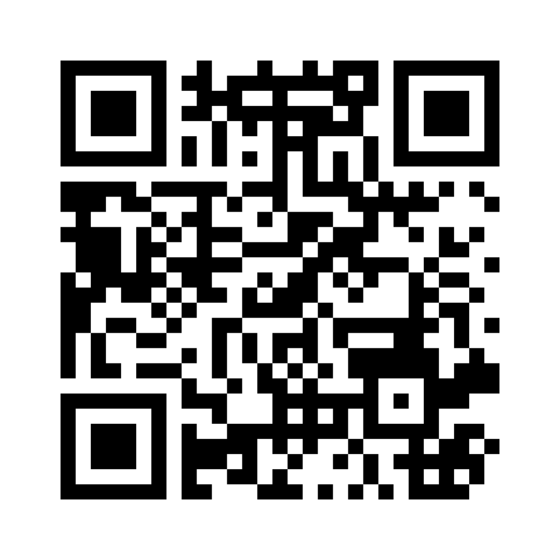
Mentimeter Checkpoint
Join at www.menti.com:
Code: 95 32 42 1
Link
https://www.menti.com/bl69ar1bwgee

Slide 21
Working with Strings
The string (str) type was briefly introduced in previous weeks
Let’s take our string knowledge to the next level!
escape sequences
str operations
type conversion
str indexing and slicing
str methods

Slide 22
String Methods
Strings are objects and just like other objects, the str type has associated methods that are only valid for strings
To find out which methods are associated with objects, use the built-in function dir
>>> dir(str)
['__add__', '__class__', '__contains__', '__delattr__', '__dir__', '__doc__', '__eq__', '__format__', '__ge__', '__getattribute__', '__getitem__', '__getnewargs__', '__gt__', '__hash__', '__init__', '__init_subclass__', '__iter__', '__le__', '__len__', '__lt__', '__mod__', '__mul__', '__ne__', '__new__', '__reduce__', '__reduce_ex__', '__repr__', '__rmod__', '__rmul__', '__setattr__', '__sizeof__', '__str__', '__subclasshook__', 'capitalize', 'casefold', 'center', 'count', 'encode', 'endswith', 'expandtabs', 'find', 'format', 'format_map', 'index', 'isalnum', 'isalpha', 'isascii', 'isdecimal', 'isdigit', 'isidentifier', 'islower', 'isnumeric', 'isprintable', 'isspace', 'istitle', 'isupper', 'join', 'ljust', 'lower', 'lstrip', 'maketrans', 'partition', 'replace', 'rfind', 'rindex', 'rjust', 'rpartition', 'rsplit', 'rstrip', 'split', 'splitlines', 'startswith', 'strip', 'swapcase', 'title', 'translate', 'upper', 'zfill']

Slide 23
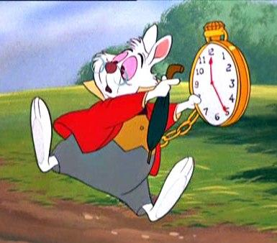
String Method: upper
upper is a string method that generates a new string that has all upper case characters
>>> white_rabbit = ”I’m late! I’m late! For a very important date!”
>>> white_rabbit.upper()
“I’M LATE! I’M LATE! FOR A VERY IMPORTANT DATE!”
>>> white_rabbit
“I’m late! I’m late! For a very important date!”

Slide 24
String Method: lower
lower is a string method that generates a new string that has all lower case characters
>>> white_rabbit = ”I’m late! I’m late! For a very important date!”
>>> white_rabbit.lower()
”i’m late! i’m late! for a very important date!”
>>> white_rabbit
“I’m late! I’m late! For a very important date!”

Slide 25
String Method: find (and rfind)
The method find returns first index where a substring is found
The method rfind returns the last index where a substring is found
Returns -1 if no such substring exists
>>> white_rabbit = ”I’m late! I’m late! For a very important date!”
>>> white_rabbit.find(‘late’)
4
>>> white_rabbit.rfind(‘late’)
14

Slide 26
String Method: replace
The method replace(old, new) returns a copy of the string in which the occurrences of old have been replaced with new.
>>> white_rabbit = ”I’m late! I’m late! For a very important date!”
>>> white_rabbit.replace(‘late’,’early’)
“I’m early! I’m early! For a very important date!”

Slide 27
Chaining Methods
How would you replace the word “forward” with “backward”?
Methods can be chained together
Perform first operation, which returns an object
Use the returned object for the next method
>>> s = ‘Forward, forward we must go, for there is no other way to go!’
>>> s.lower().replace(‘forward’,’backward’)
‘backward, backward we must go, for there is no other way to go!’
>>> s.lower().replace(‘forward’,’backward’).capitalize()
‘Backward, backward we must go, for there is no other way to go!’

Slide 28
More String Methods
There are many more string methods available which you will explore in lab assignments and tutorials
str.islower()
str.count(sub)
str.ljust(width)
str.lstrip()
str.split()
str.strip()
Do not need to memorize all of the string methods!
Should know:
str.lower
str.upper
str.find
str.rfind
str.replace
str.capitalize
(any others will be indicated in the review)

Slide 29

Let’s Code!
Let’s take a look at how this works in Python!
String methods
capitalize
upper
lower
find
rfind
And more…
Open your notebook
Click Link:
4. String Methods

Slide 30
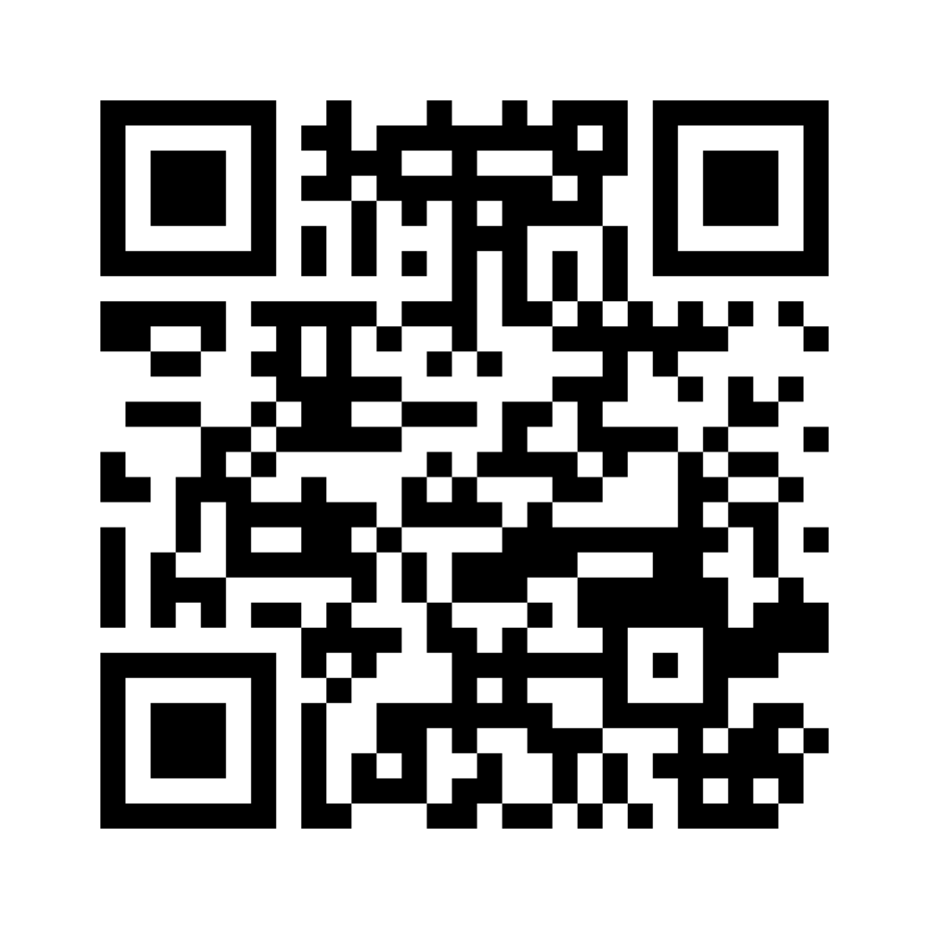
Mentimeter Checkpoint
Join at www.menti.com:
Code: 9493 9270
Link
https://www.menti.com/bldrkshx7mcz

Slide 31
Strings: Conversions, Indexing, Slicing, Immutability.
Week 3 | Lecture 1 (3.1.2)

